Slide 1
Randomized Algorithms CS648
Lecture 23
Fixed path routing
Leader election in distributed environment

Slide 2
Birthday paradox

Slide 3
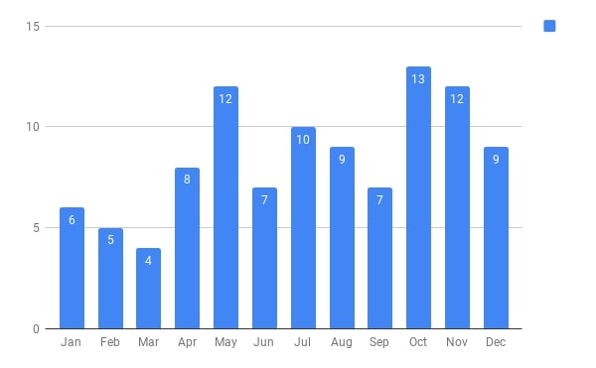
Birthdays of students who were present in the 1st class of CS203B
There are 102 students and 365 days.
What might be the chances of two students sharing a birthday ?

Slide 4



















































First 25 students
First 50 students
First 75 students
All 102 students
$$2$$
$$7$$
$$11$$
$$31$$
$$≈28$$
$$2$$
$9$^{th} January
$$3$$
$5$^{th} May
$$2$$
$27$^{th} July
$$2$$
$9$^{th} January
$$2$$
$9$^{th} January
$$2$$
$3$^{rd} June
$$3$$
$27$^{th} July
$$3$$
$27$^{th} July
$$2$$
$7$^{th} July
$$3$$
$27$^{th} July
$$2$$
$7$^{th} October
$$2$$
$2$^{th} October
$$2$$
$2$^{th} October
$$2$$
$7$^{th} October
$$2$$
$22$^{th} October
Can we explain this ?
$7$^{th} October
$$2$$
$8$^{th} December
$$3$$
$$2$$
$26$^{th} October
$$2$$
$1$^{st} November
$$2$$
$4$^{th} November
Yes, using a model studied multiple times in this course
$$2$$
$14$^{st} November
$$2$$
$10$^{th} December
Prob.>$0.5$
Prob.>$0.97$
Prob.>$0.9997$
Prob.>$0.9999997$

Slide 5
Balls into BINS

Slide 6

Balls into Bins
1 2 3 4 5 … $j−1$ $j$
Ball-bin Experiment: There are $j$ balls and $n$ bins.
Each ball selects its bin randomly uniformly and independent of other balls
and falls into it.
1 2 3 … $i$ … $n$

Slide 7
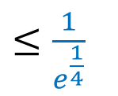
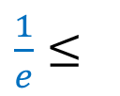


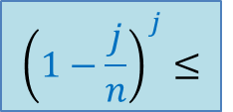

Balls into Bins
1 2 3 4 5 … $j−1 j$
Question : What is the probability that no bin has more than one ball ?
$$1⋅\left(1−\frac{1}{n}\right)⋅\left(1−\frac{2}{n}\right)⋅⋅⋅\left(1−\frac{j−1}{n}\right)$$
1 2 3 … $i$ … $n$
For $j=\sqrt{n}$
$${\left(1−\frac{j}{n}\right)}^{j}≤$$
$${≤\left(1−\frac{j}{2n}\right)}^{\frac{j}{2}}$$
$\frac{1}{e}≤$
$≤\frac{1}{e^{\frac{1}{4}}}$

Slide 8
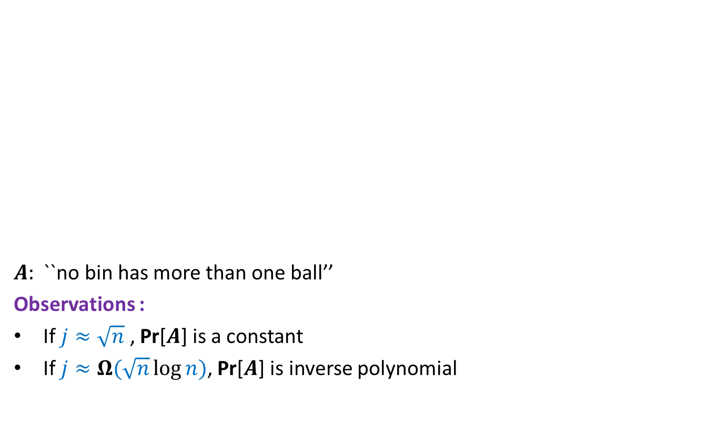
Balls into Bins
1 2 3 4 5 … $j−1 j$
$A:$ ``no bin has more than one ball’’
Observations :
If $j≈\sqrt{n}$ , Pr[$A$] is a constant
If $j≈Ω(\sqrt{n}\log{n})$, Pr[$A$] is inverse polynomial
1 2 3 … $i$ … $n$

Slide 9
Routing
Distributed
Packet has (source, destination)
Routing table

Slide 10
Dilation :
Congestion :
Queue management :
The maximum length of any path
The maximum number of packets that cross any edge
Policy of breaking ties

Slide 11
Fixed Path Routing

Slide 12
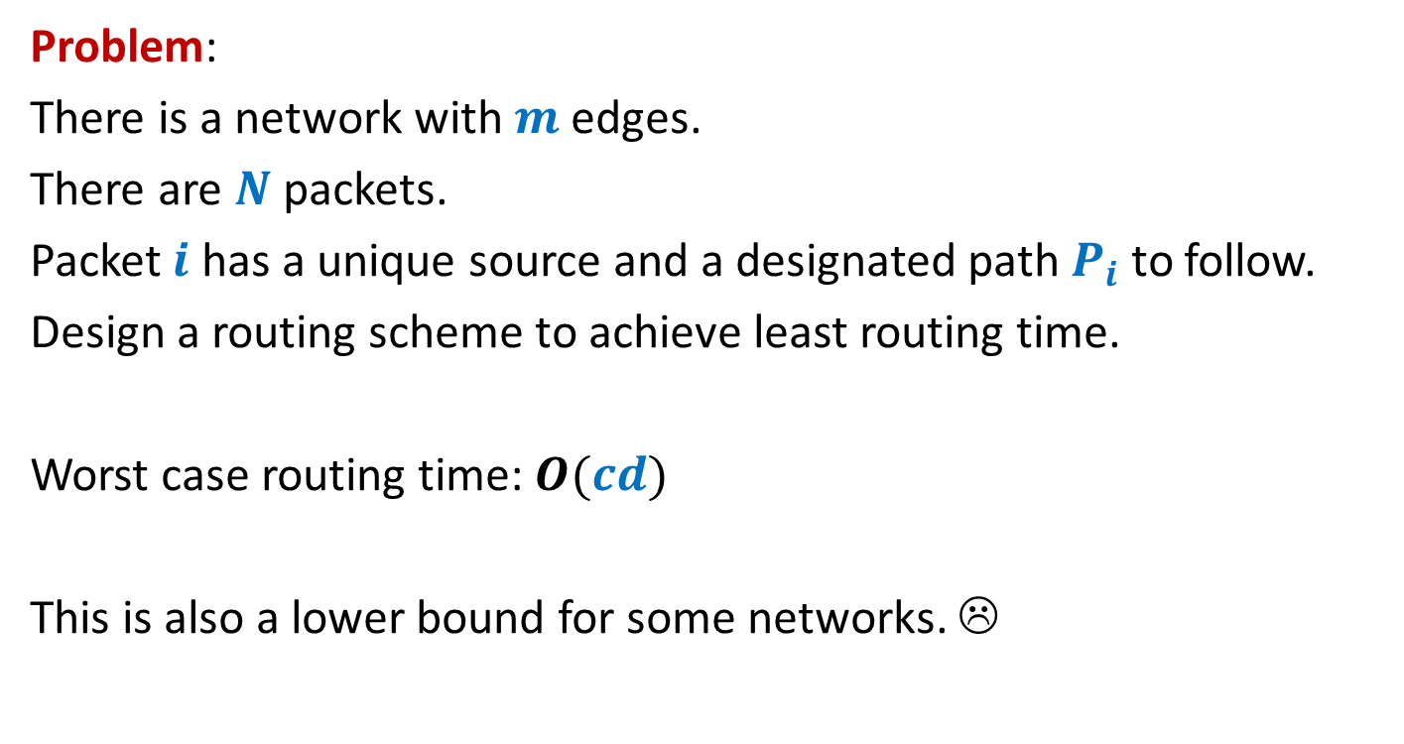
Arbitrary network
Problem:
There is a network with $m$ edges.
There are $N$ packets.
Packet $i$ has a unique source and a designated path $P_{i}$to follow.
Design a routing scheme to achieve least routing time.
Worst case routing time: $O(cd)$
This is also a lower bound for some networks. ☹

Slide 13






Worst case example
There can be a network with congestion $c$ and dilation $d$
such that routing time = $(c+1)\frac{d}{2}$
$$d=2$$
Routing time: $c+1$
. . .
$$1$$
$$2$$
$$c$$
We can give construction for any arbitrary even $d$ recursively.

Slide 14



Worst case example
There can be a network with congestion $c$ and dilation $d$
such that routing time = $(c+1)\frac{d}{2}$
$$1$$
$$2$$
$$c$$
. . .

Slide 15

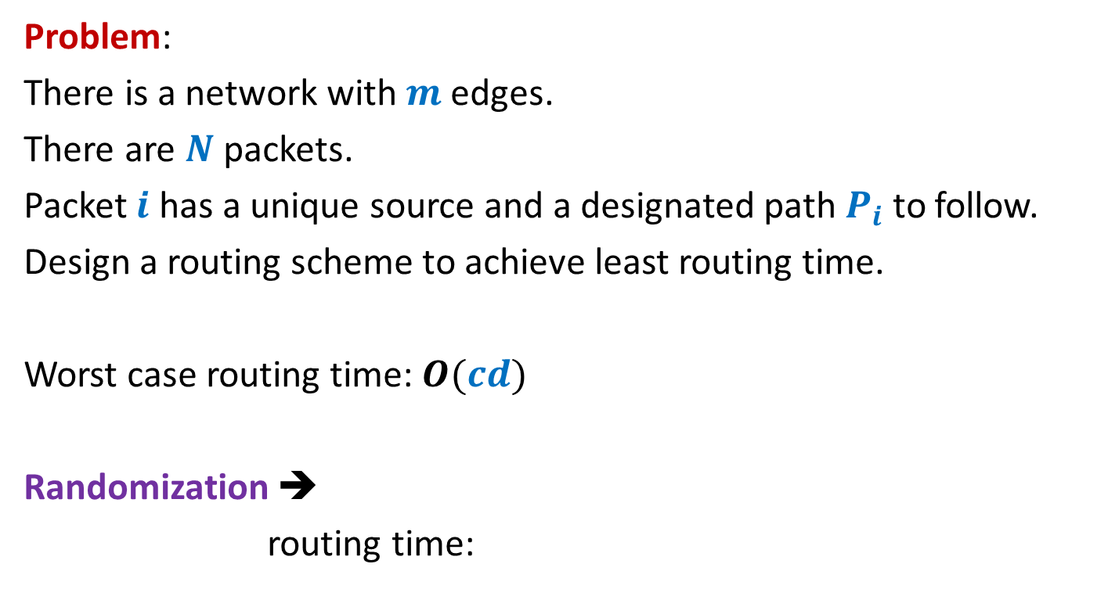
Arbitrary network
Problem:
There is a network with $m$ edges.
There are $N$ packets.
Packet $i$ has a unique source and a designated path $P_{i}$to follow.
Design a routing scheme to achieve least routing time.
Worst case routing time: $O(cd)$
Randomization ➔
routing time:
$$O(c+d log mN)$$

Slide 16




Focus on an edge
$$P_{c}$$
Aim:
To ensure that no two paths cross the edge $e$ at the same time.
$$e$$
$$P_{1}$$

Slide 17
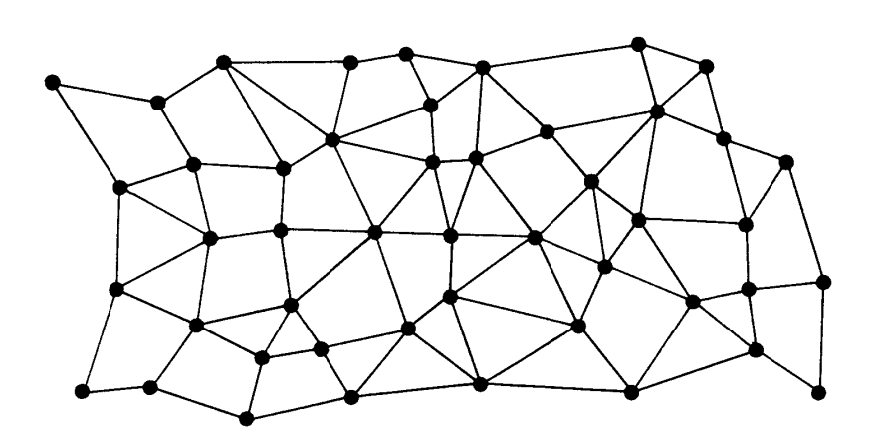



The difficulty
$$e$$
Assumption 1 :
Each packet that passes through $e$
reaches the source of $e$
at the right time

Slide 18
Focus on an edge
$$P_{c}$$
Aim:
To ensure that no two paths cross the edge $e$ at the same time.
$$e$$
$$P_{1}$$

Slide 19
Idea 1
A random delay

Slide 20

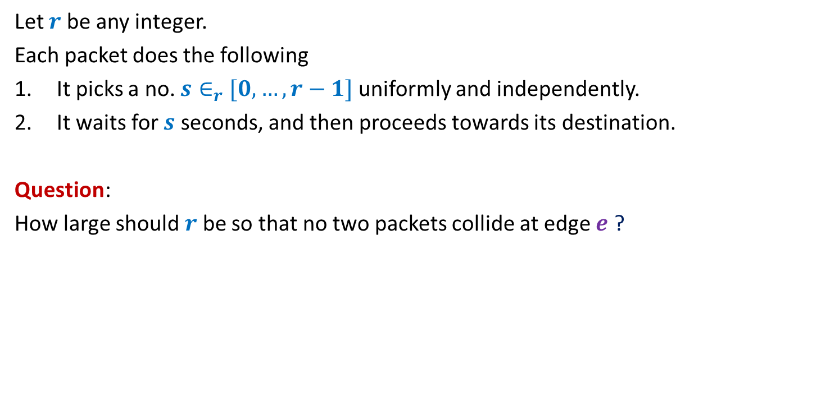

A random delay
Let $r$ be any integer.
Each packet does the following
It picks a no. $s∈_{r}$ $[0,…,r−1]$ uniformly and independently.
It waits for $s$ seconds, and then proceeds towards its destination.
Question:
How large should $r$ be so that no two packets collide at edge $e$ ?
Even for $r$= $c^{2}$,
there will be collision with probability $≈1/e$

Slide 21

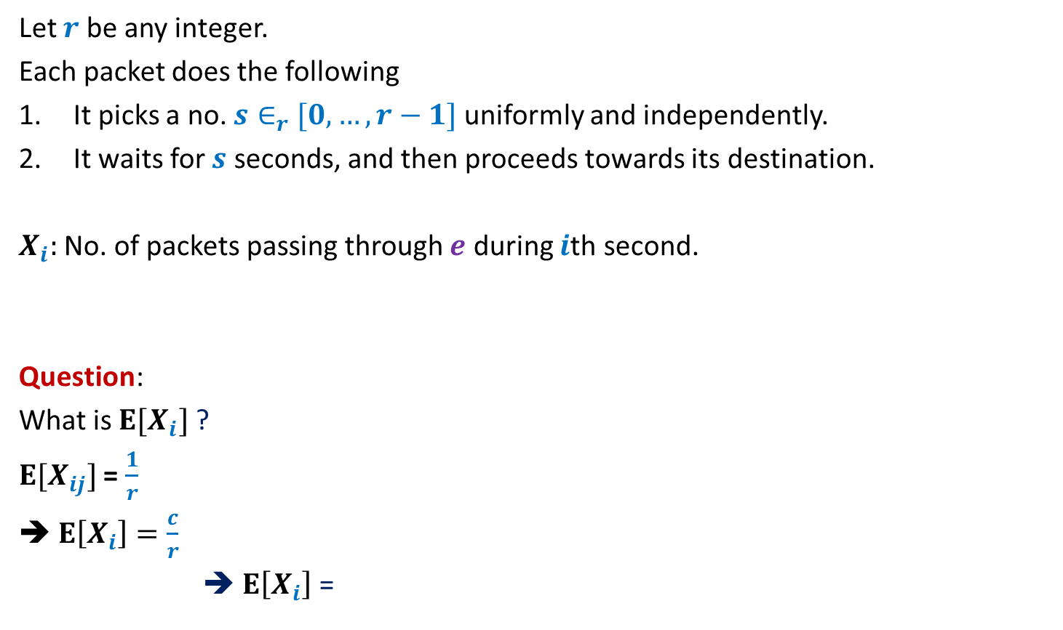

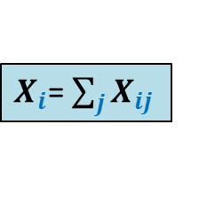
A random delay
Let $r$ be any integer.
Each packet does the following
It picks a no. $s∈_{r}$ $[0,…,r−1]$ uniformly and independently.
It waits for $s$ seconds, and then proceeds towards its destination.
$X_{i}:$ No. of packets passing through $e$ during $i$th second.
Question:
What is $E[X_{i}]$ ?
$E[X_{ij}]$ = $\frac{1}{r}$
➔ $E\left[X_{i}\right]=\frac{c}{r}$
➔ $E\left[X_{i}\right]$ =
$$X_{ij}=\left\{\begin{aligned} 1 if packet j passes through edge e in i th second \\ 0 otherwise \end{aligned}\right.$$
$X_{i}$= $\sum_{j}{X_{ij}}$
Fix $r$ = $\frac{c}{log Nm}$
$$log Nm$$

Slide 22
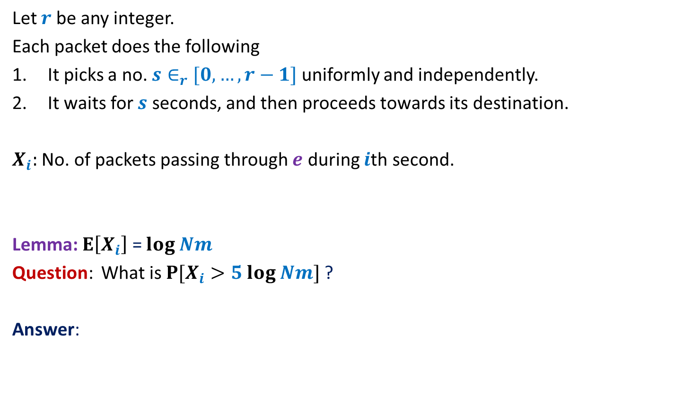
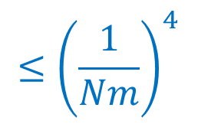
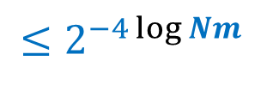
A random delay
Let $r$ be any integer.
Each packet does the following
It picks a no. $s∈_{r}$ $[0,…,r−1]$ uniformly and independently.
It waits for $s$ seconds, and then proceeds towards its destination.
$X_{i}:$ No. of packets passing through $e$ during $i$th second.
Lemma: $E\left[X_{i}\right]$ = $log Nm$
Question: What is $P[X_{i}>5 log Nm]$ ?
Answer:
$$X_{ij}=\left\{\begin{aligned} 1 if packet j passes through edge e in i th second \\ 0 otherwise \end{aligned}\right.$$
$$≤{\left(\frac{1}{Nm}\right)}^{4}$$
$${≤2}^{−4\log{Nm}}$$

Slide 23
How to proceed further ?
How to get rid of Assumption 1 ?
Homework: Attempt these questions.
We shall answer them in the next class.
Hint: We have traversed more than 80% of the path to the solution.

Slide 24
Leader Election
Distributed environment

Slide 25
Distributed Algorithms

Slide 26


Each node has a processor, a small RAM, and a unique identifier.
Each processor can only interact with its neighboring processors.
$$u$$
$$u$$
Network of processors
How does a distributed algorithm work ?
The algorithm proceeds in rounds.

Slide 27
Round
Send messages to neighbours
Receive messages from neighbours
Do local computation
$$u$$

Slide 28
Round
$i$th round
$$u$$
$$v$$

Slide 29
Round
$i$th round
$(i+1)$th round
.
.
.
Complexity measures of a distributed algorithm:
No. of rounds
No. of messages sent
Length of each message
$$u$$
$$v$$

Slide 30

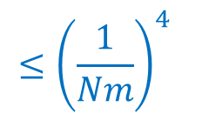
Leader Election in a complete network
Implicit
There are $n$ nodes.
Each node is connected to every other node.
Each node
knows $n$.
can send a message to its neighbours.
can do local computation.
A single node : “leader”
Every other node is a slave
Every node knows the leader
$$n=5$$
Find a leader

Slide 31
Leader Election in a complete network
Implicit
There are $n$ nodes.
Each node is connected to every other node.
Each node
knows $n$.
can send a message to its neighbours.
can do local computation.
A single node : “leader”
Every other node is a slave
Only leader knows that he/she is leader
$$n=5$$
Find a leader

Slide 32
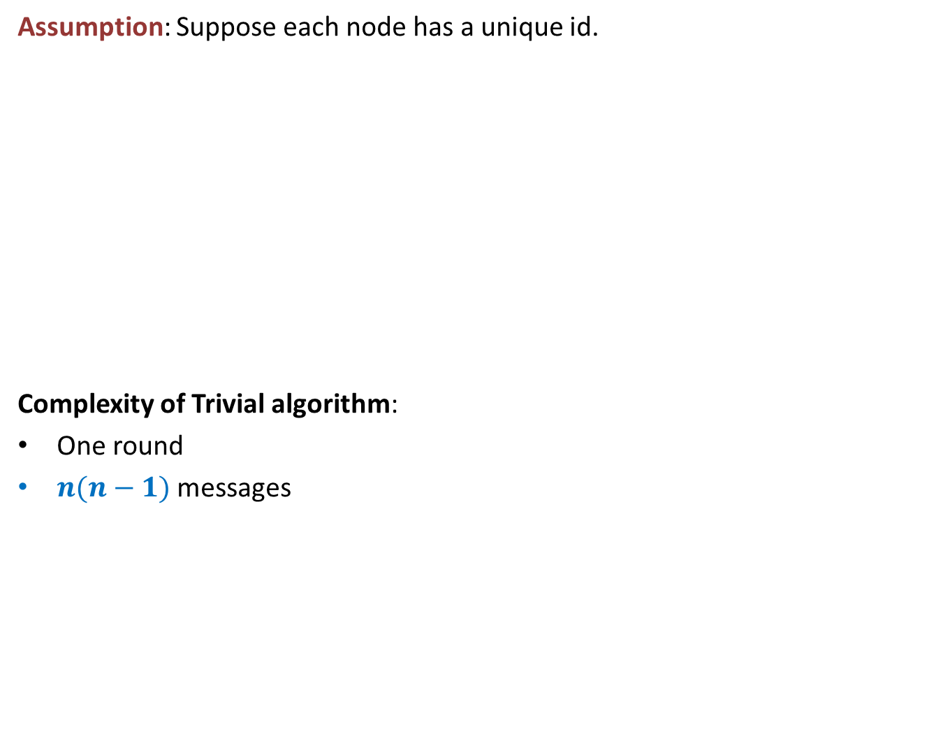
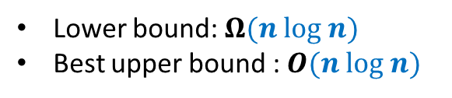
Leader Election in a complete network
Implicit
Assumption: Suppose each node has a unique id.
Complexity of Trivial algorithm:
One round
$n(n−1)$ messages
Trivial algorithm:
Each node broadcasts its id.
The node with highest id is the leader.
Can you use this assumption as a hint to design an algorithm ?
$$n=5$$
Find a leader
Deterministic algorithms
Lower bound: $Ω(n log n)$
Best upper bound : $O(n log n)$

Slide 33
What can randomization offer ?

Slide 34
What can randomization offer ?

Slide 35

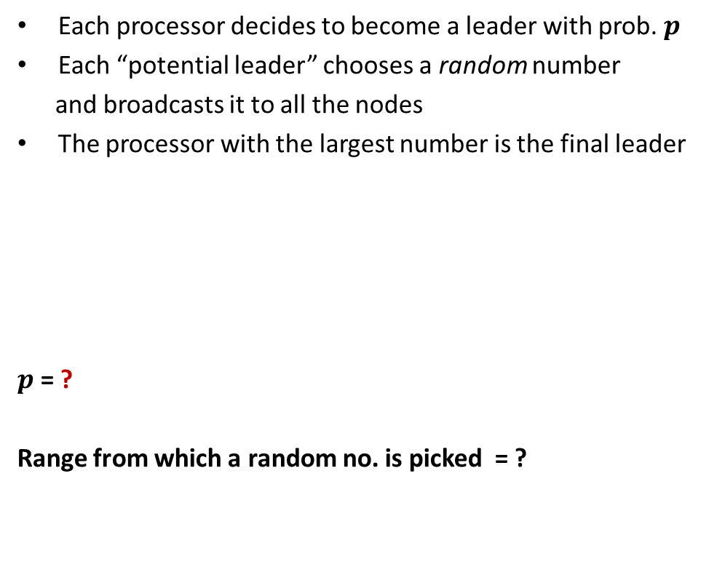
What can randomization offer ?
We can do even better ☺
$\sqrt{n} polylog n$ messages
Each processor decides to become a leader with prob. $p$
Each “potential leader” chooses a random number
and broadcasts it to all the nodes
The processor with the largest number is the final leader
$p$ = ?
Range from which a random no. is picked = ?
$$\frac{3\left(log n\right)}{n}$$
To Ensure that there is at least one potential leader with high probability.
$$[1,n^{4}]$$
To ensure that no two potential leaders pick the same random number.
Messages communicated : $O(n log n)$
No. of rounds : $1$
Success probability :
$$>1−2n^{−3}$$

Slide 36
What can randomization offer ?
We can do even better ☺
$\sqrt{n} polylog n$ messages
Each processor decides to become a leader with prob. $p$
Each “potential leader” chooses a random number
and broadcasts it to all the nodes
The processor with the largest number is the final leader
$p$ = ?
Range from which a random no. is picked = ?
$$\frac{3\left(log n\right)}{n}$$
$$[1,n^{4}]$$
Messages communicated : $O(n log n)$
No. of rounds : $1$
Success probability :
$$>1−2n^{−3}$$

Slide 37
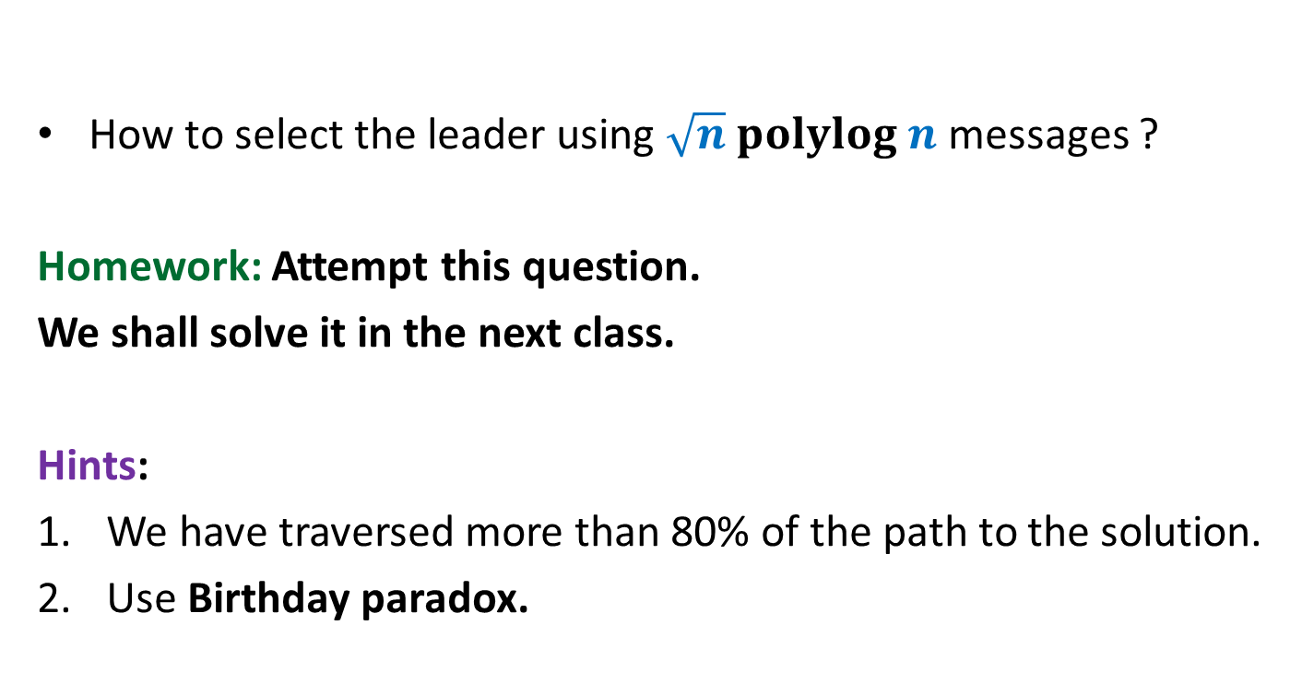
How to select the leader using $\sqrt{n} polylog n$ messages ?
Homework: Attempt this question.
We shall solve it in the next class.
Hints:
We have traversed more than 80% of the path to the solution.
Use Birthday paradox.

